Slide 1
COURSE CODE: SCS1207
COURSE : COMPUTER ARCHITECTURE AND ORGANIZATION
TITLE – CHARACTERISTICS OF MULTIPROCESSORS(UNIT 5)
T. Gomathi, M.Tech,(Ph.D)
Assistant Professor,
School of Electrical and Electronics,
Sathyabama Institute of Science and Technology,
Chennai.

Slide 2
CONTENTS
Multiprocessor
Types of multiprocessor
Loosely coupled multiprocessor system
Tightly coupled multiprocessor system
Homogeneous multiprocessor system
Heterogeneous multiprocessor system
Shared memory multiprocessor system
Distributed memory multiprocessor system
Uniform memory access (UMA) system
cc–NUMA system

Slide 3
MULTIPROCESSOR
The use of two or more central processing units within a single computer system.
Such CPUs will have shared access to a common RAM
Can able to allocate specific task requiring single or multi processors.

Slide 4
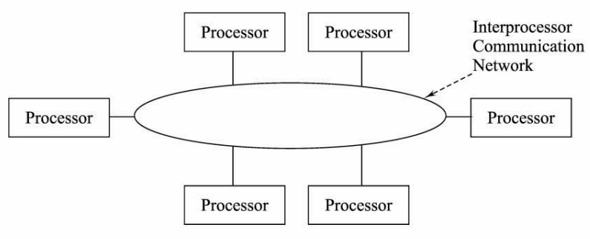
BASIC MULTIPROCESSOR ARCHITECTURE

Slide 5
BENEFITS OF MULTIPROCESSOR
Increases reliability of the system
Improved Performance
Increases the speed
Fault tolerance
Application Matching

Slide 6
TYPES OF MULTIPROCESSOR
Loosely coupled multiprocessor system
Tightly coupled multiprocessor system
Homogeneous multiprocessor system
Heterogeneous multiprocessor system
Shared memory multiprocessor system
Distributed memory multiprocessor system
Uniform memory access (UMA) system
cc–NUMA system
Hybrid system – shared system memory for global data and local memory for local data

Slide 7
LOOSELY-COUPLED (DISTRIBUTED MEMORY) MULTIPROCESSOR SYSTEM
Every processor will have its own local memory, input/output(I/O) channels, and operating system.
Each processor can perform multiple-instructions-on-multiple-data (MIMD) programming.
Each processor can support parallel processing.

Slide 8
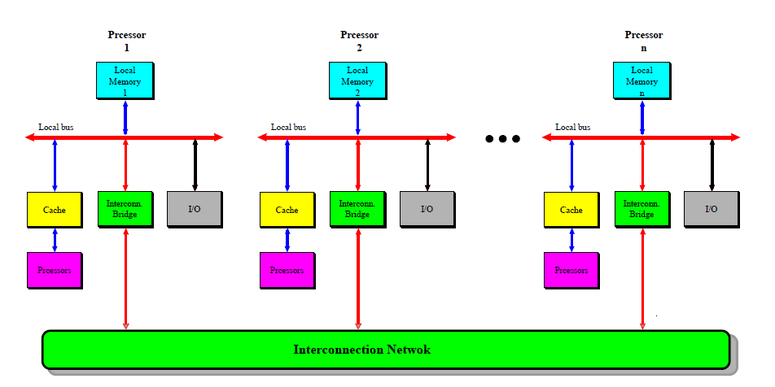
LOOSELY-COUPLED (DISTRIBUTED MEMORY) MULTIPROCESSOR SYSTEM

Slide 9
LOOSELY COUPLED CHARACTERISTICS
Performs MIMD Programming
Allows Parallel Processing
Highly scalable

Slide 10
TIGHTLY-COUPLED (SHARED MEMORY) MULTIPROCESSOR SYSTEM
Multiprocessor system with a shared memory closely connected to the processors.
A symmetric multiprocessing system is a system with centralized shared memory called main memory (MM) operating under a single operating system with two or more homogeneous processors.

Slide 11
CLASSIFICATION OF TIGHTLY COUPLED SYSTEM
These type of system can be categorized into
Uniform memory-access (UMA) system
NUMA system

Slide 12
UNIFORM MEMORY ACCESS (UMA) SYSTEM
Heterogeneous multiprocessing system
Symmetric multiprocessing system

Slide 13
HETEROGENEOUS MULTIPROCESSOR SYSTEM
It contains multiple, but not homogeneous, processing units –or any type of application-specific integrated circuits (ASICs).
The system architecture allows any accelerator –
For instance, a graphics processor – to operate at the same processing level as the system's CPU.

Slide 14
SYMMETRIC MULTIPROCESSOR SYSTEM
It a system with a pool of homogeneous processors
Running under a single OS with a centralized, shared main memory.
Each processor, has the ability to share common resources (memory, I/O device, interrupt system, and so on)
Connected using a system bus, a crossbar, or a mix of the two, or an address bus and data crossbar.

Slide 15
Contd.
Each processor has its own independent cache memory that acts as a bridge between the processor and main memory.
The function of the cache is to alleviate the need for main-memory data access, thus reducing system-bus traffic.
Use of shared memory allows for a uniform memory-access time (UMA)

Slide 16
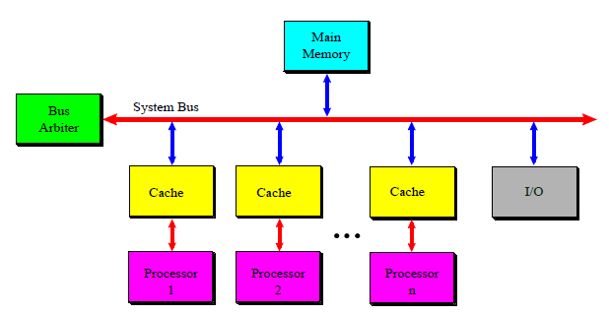
SMP - SYMMETRIC MULTIPROCESSOR SYSTEM

Slide 17
cc-NUMA SYSTEM
The architecture called "cc-NUMA" (cache coherency–non-uniform memory access) has been successfully employed.
Shared global memory which is distributed to each node.
It is slower compared to local memory access, which is why the memory access is "non-uniform".

Slide 18
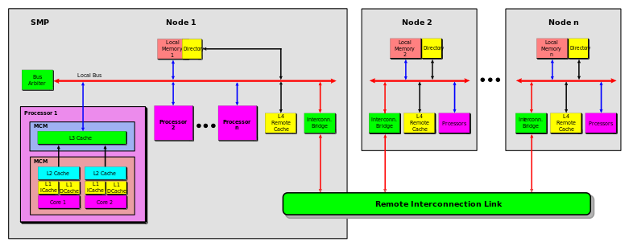
cc-NUMA SYSTEM

Slide 19
TIGHTLY-COUPLED VERSUS LOOSELY-COUPLED ARCHITECTURE
Loosely-coupled architectures feature
It high performances of each individual processor
Do not enable for easy real-time balancing of the load among processors.

Slide 20
Contd.
Tightly-coupled architectures feature
easy load-balancing and distribution among processors
suffer from the bottleneck consisting in the sharing of common resources through one or more buses.

Slide 21
MULTIPROCESSOR SYSTEM FEATURING GLOBAL DATA MULTIPLICATION
The common resources are accessible from all processors via the system bus.
The local resources are only accessible to the local processor.
Cache memories can be viewed in this perspective as local memories.
The local memory is divided into two sectors viz. global data (GD) and local data (LD).

Slide 22
Contd.
The global data, is modifiable information, accessible by all processors.
This information is duplicated and stored in each local memory of each processor.
Once the global data gets modified in a local memory, a hardware write-broadcasting is sent
Thus, global data may be read by each processor accessing its own local memory without involving the system bus.
System bus access is only required when global data is modified in a local memory to update the copy of this data stored in the other local memories.
Local data can be exchanged in a loosely coupled system via message passing.

Slide 23
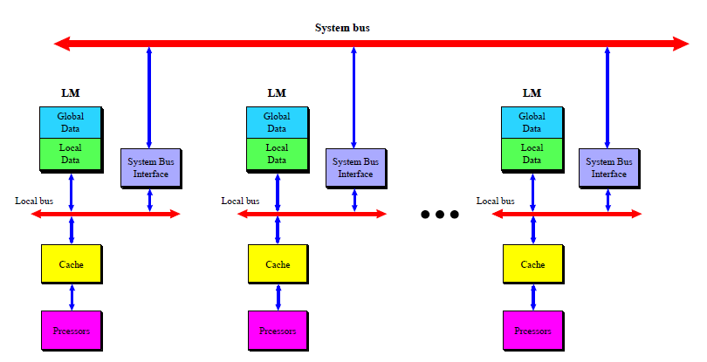
MULTIPROCESSOR SYSTEM FEATURING GLOBAL DATA MULTIPLICATION

Slide 24
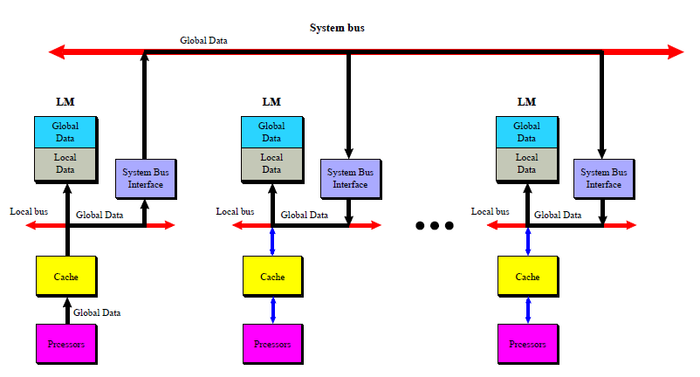
MULTIPROCESSOR SYSTEM GLOBAL DATA WRITE-BROADCASTING

Slide 25
THANK YOU

